Slide 1


Property & Asset
Management
Joel Prentice
Director of Property & Asset Management

Slide 2

Working With Us
Who are we?
  Joel Prentice – Director of Property & Asset Management (2022)
    Diocesan senior staff
    Property & Finance committee
    Insurance & Cemeteries subcommittees
    Provincial Insurance & Risk Management task force
    Cathedral Hill Foundation board
    Serson Clarke Non-Profit Housing Corporation board
  Amy Elliot – Property Operations Coordinator (2024)
    Diocesan support for property matters
    Property & Finance committee support
    Investment subcommittee support

Slide 3
Working With Us
How can we support you?
  Property Insurance
    Filing a claim, diocesan self-insurance, events insurance,
  Heritage Designations
    Navigating existing designations, responding to proposed designations, +
  Leasing & Rentals
    Residential tenancies, licensing agreements, commercial leases, +
  Maintenance
    Preventative maintenance programs, reactive maintenance concerns, +
  Capital Projects
    Scoping, feasibility, governance, contractor relations, +

Slide 4
Working With Us
How to connect with us?
  Email property@ottawa.anglican.ca
  Call 613-232-7124 x 231

Slide 5
Property Insurance
ADO works with parishes, Hub International (our broker), Ecclesiastical Insurance (our insurer)
  Diocesan insurance program is negotiated annually
    Due diligence from Insurance subcommittee with Hub International
    Presented to, and approved by Property & Finance committee

Slide 6
Property Insurance
  Property insurance occupies majority of the ADO's overall insurance program
    We pay $901k in annual premiums in 2026
    Of that amount, $696k of the total premiums cover property insurance
    Premiums don't include self-insurance cost (
    $347m in insured property assets

Slide 7
Property Insurance
  Working with Provincial Insurance & Risk Management Task Force
    Consult with various dioceses around our program details
    Applying pressure to Ecclesiastical as part of a larger group
    Engage consultants to recommend longer term insurance strategies

Slide 8
Property Insurance
What to consider following a property 'incident'?
  If crime is involved or suspected, file a police report
  Document details (log a summary, timeline, photos, videos, +)
  Call our office immediately (call Hub International directly if after hours)
    We can determine if the issue is insurable
    We will offer support for stabilization efforts
      Best practices, examine health & safety concerns
      Contacts of restoration crews or general contractors

Slide 9
Property Insurance
  If insurable, a claim is filed with Ecclesiastical Insurance
    They send a third party insurance adjuster (may take a few days)
    Adjuster determines remedial scope of work and costing (may take several weeks)
    Adjuster leads RFP process, ideally with 3+ bids (may take several weeks)
    Parish chooses winning bid, may require diocesan approvals if above certain thresholds
  Distinguishing between parish deductible ($2,500) and Diocesan deductible ($25,000)
    Self insurance is limited to property damage; does not include loss (ie. theft)

Slide 10
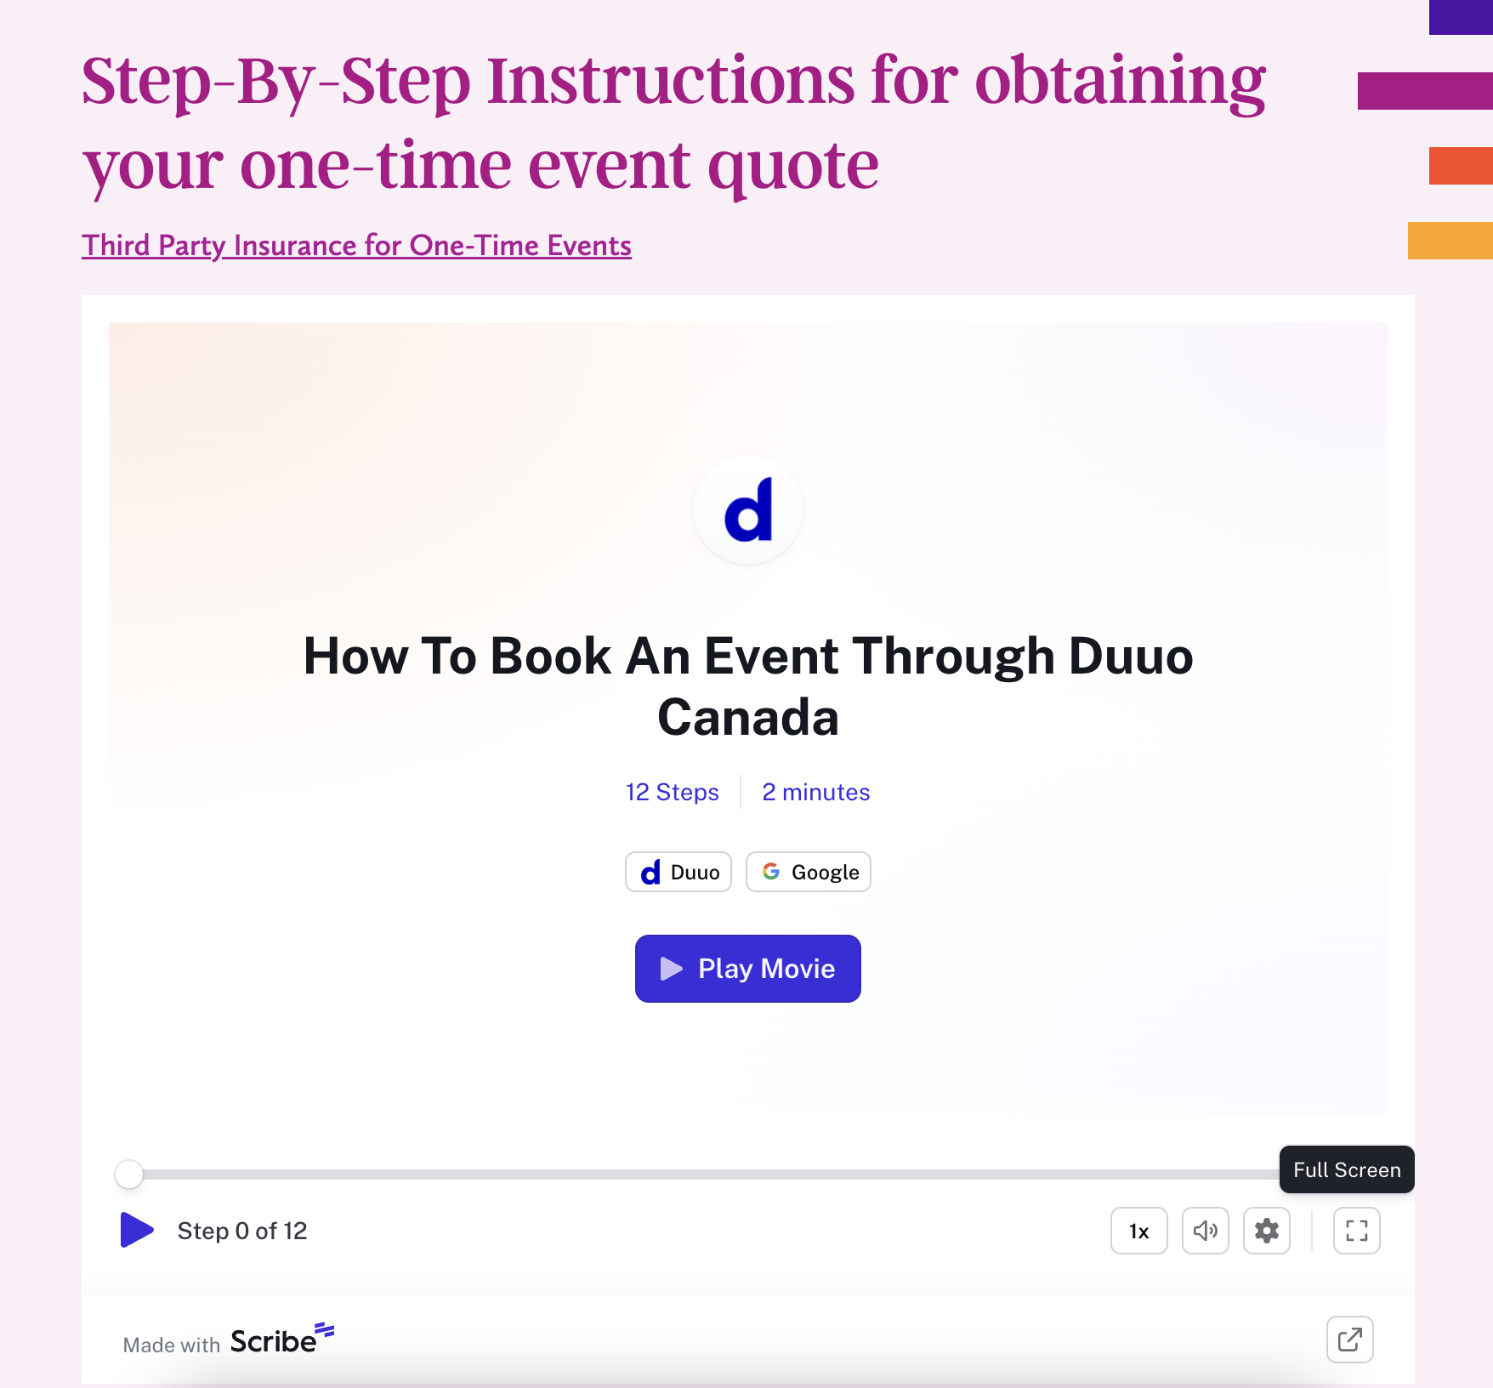
Property Insurance
Event insurance for one-time rentals
  Insurance certificates required from third party renters
  Obtained through Duuo Canada online (see Property website for details)

Slide 11
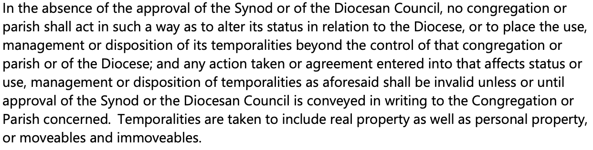
Heritage Designations

Slide 12
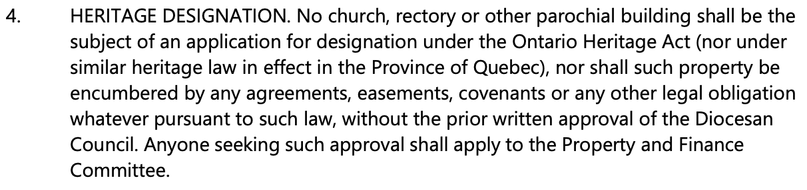
Heritage Designations

Slide 13
Heritage Designations
Heritage Act (Ontario) / Cultural Heritage Act (Quebec)
  Gives municipalities mandate to create and operate municipal heritage register, including
    Designated properties
    Non designated 'listed' or 'cited' properties of cultural heritage value or interest

Slide 14
Heritage Designations
What if our parish receives a notice of intent to designate parish property as heritage?
  Notify our diocese immediately – we will consult with the local municipality
    Statement of cultural value, description of heritage attributes will be issued
    Appeals are made to municipality, and provinces to counter designations
What if we already have a designated property?
  Impacts title of property, and insurance requirements
  Often (but not always) involves exterior of building but not necessarily interior
  Heritage permits or municipal council approval required prior to alterations and renovations
  Can sometimes tap into granting opportunities when work is required

Slide 15
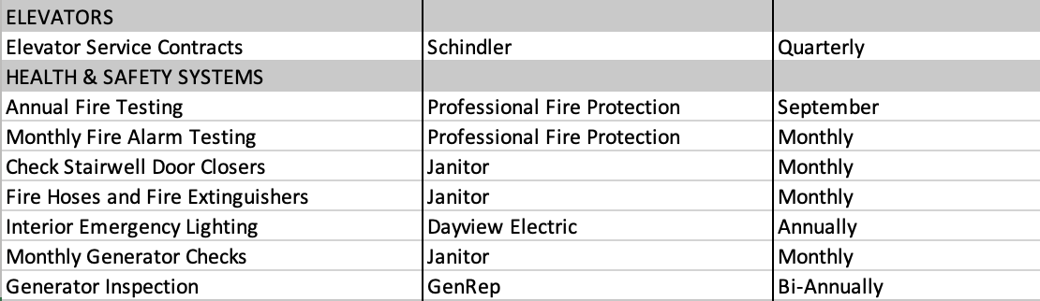
Maintenance
Preventative maintenance checklist
  Customized asset management categories
  Identifies who is responsible for those systems/components
  Marks service intervals

Slide 16
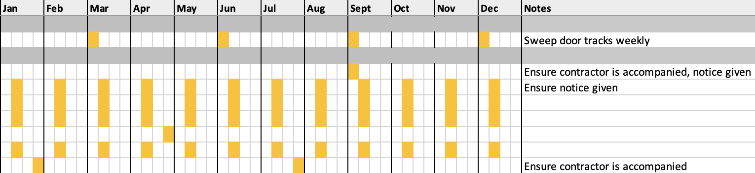
Maintenance
Preventative maintenance checklist continued
  Visualises intervals by which service/inspections are performed
  Notes section allows for information sharing around specific categories

Slide 17
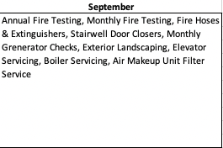
Maintenance
Preventative maintenance calendar function
  Groups all activities from checklist which take place within a given month
  This format allows for ease of planning and tracking by committee
  Creates agenda items for property committee meetings by month, ensuring accountability

Slide 18
Maintenance
Discussion – recent diocesan examples of reactive maintenance
Support for reactive maintenance concerns – where would you look to?
  My office (property@ottawa.anglican.ca)
  Regional Deans
  Neighbouring parishes/other denominations
Delegation and cooperation is key
  Property committee structure supports reactive maintenance efforts
  Custodians and on-site staff, if available, are key resources for urgent responses
  Third party service providers with service contracts can be leveraged in times of need

Slide 19
Leasing & Rentals
Residential Tenancies
  When pursuing new tenants, screening process is crucial
  Our office offers support in navigating standard lease agreements, tenancy issues, bylaw concerns
  Landlord Tenant Board (ON) & Tribunal Administratif du Logement (QC) considerations

Slide 20
Leasing & Rentals
Commercial Leases
  Leases with 2+ year terms require Property & Finance committee approval
  We offer support with negotiation/lease extension process, managing tenant relations
  Use of diocesan lease agreement template, or engaging a lawyer required

Slide 21
Leasing & Rentals
Events & Recurring Rental of Parish Space
  Compatibility of renters must be evaluated
  Use of licensing agreement template required
  Third party liability insurance required (single use renters to use online event insurance function)

Slide 22
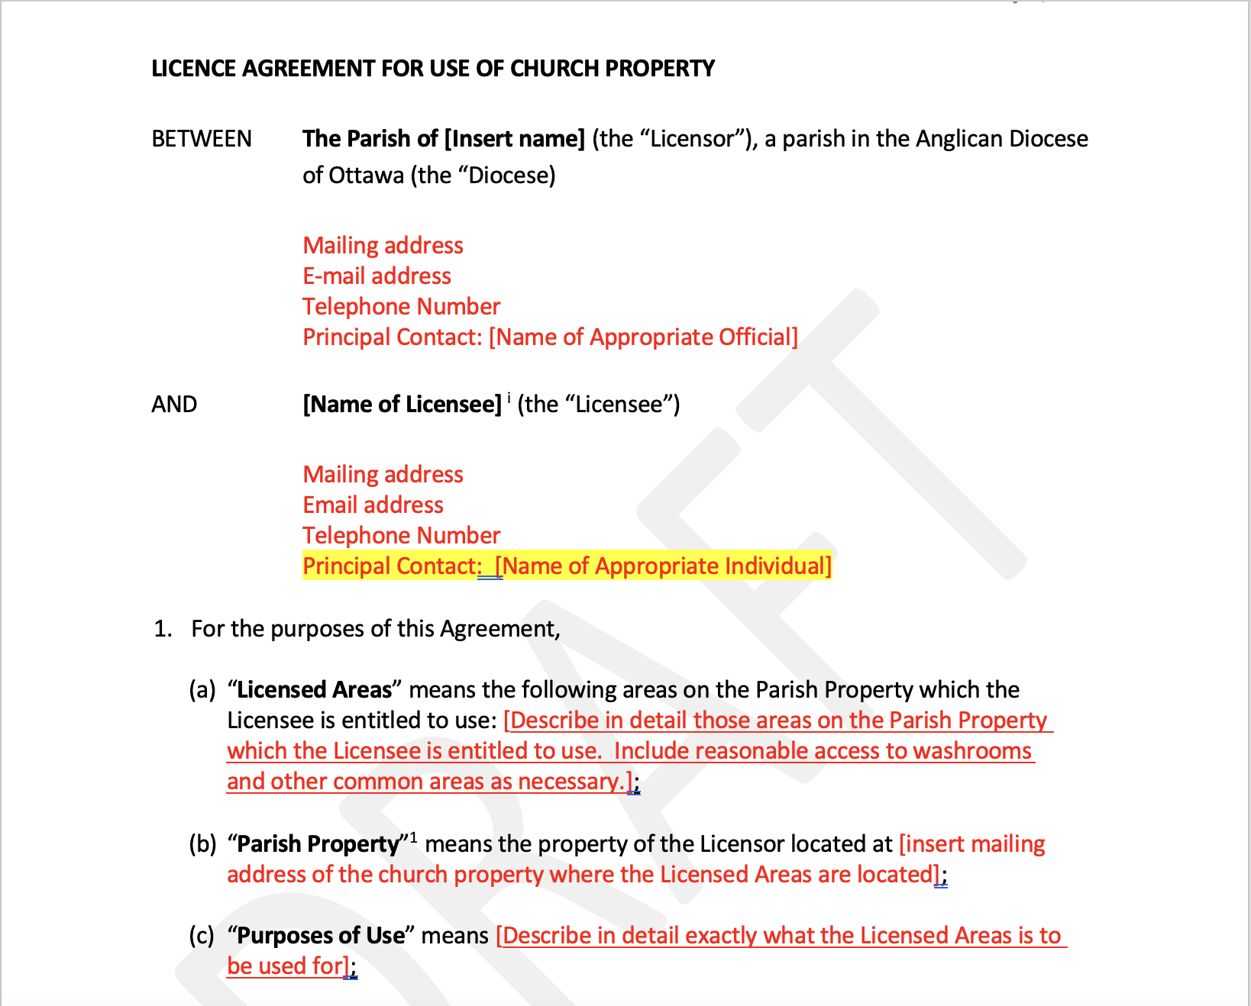
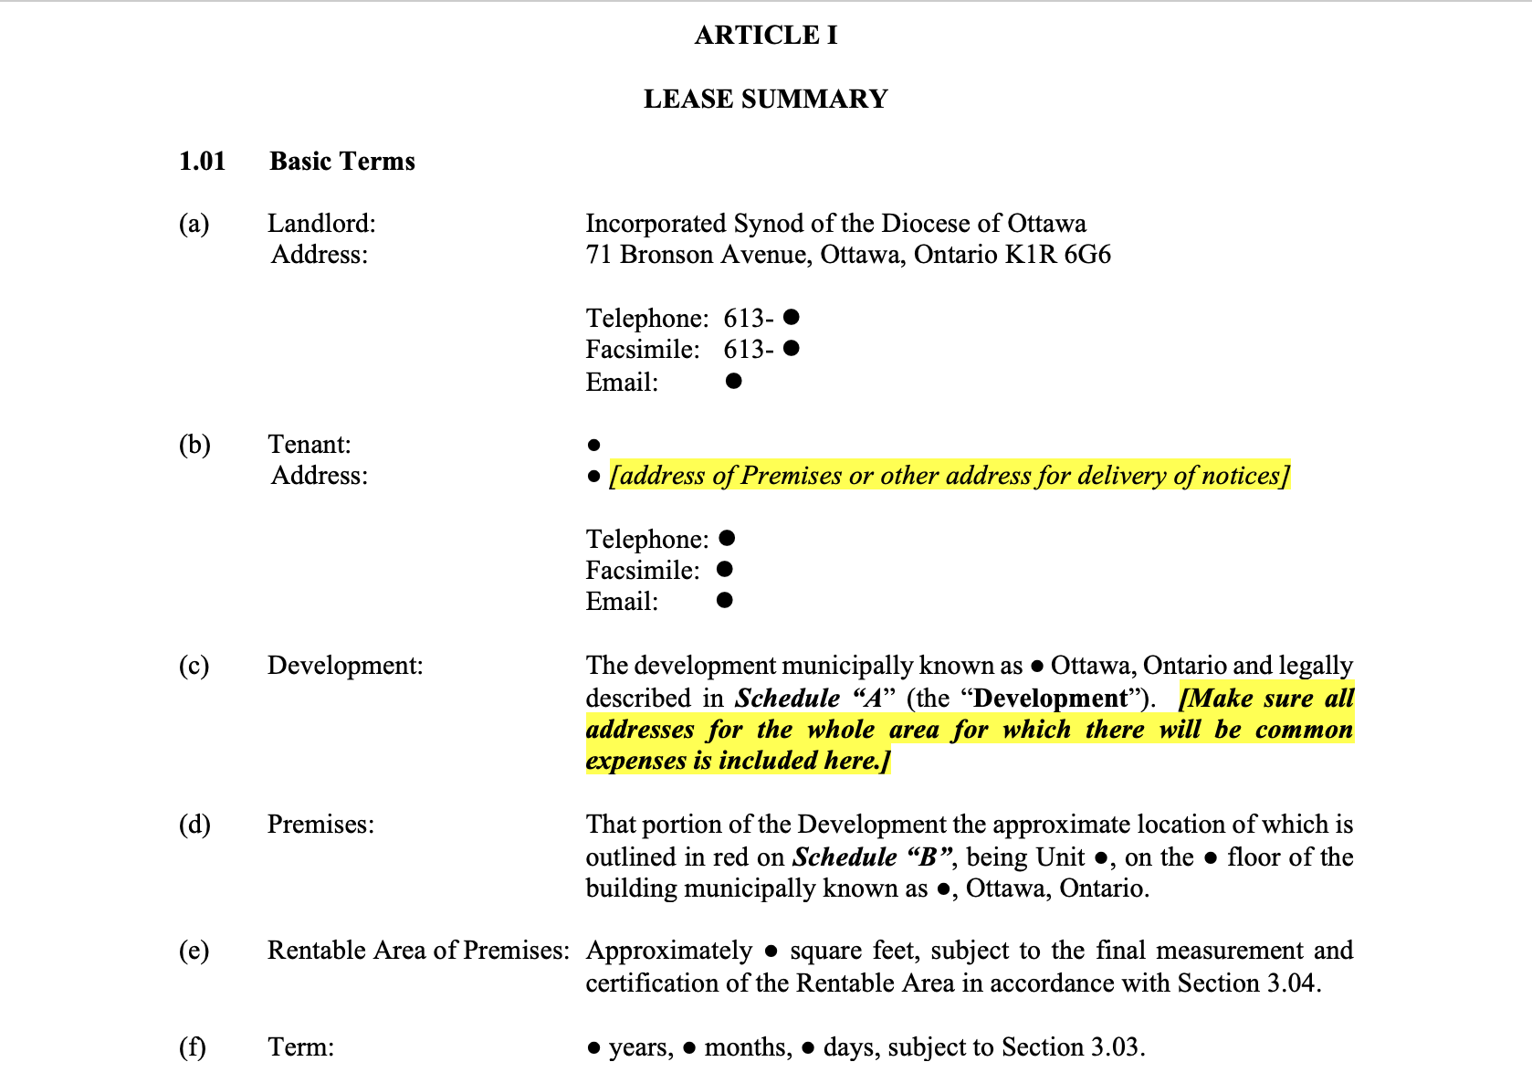
Leasing & Rentals
  Licensing agreement template and commercial lease template available online

Slide 23
Capital Projects
Scoping
  What important/urgent problem requires a solution?
  Identifying proper scope of work & project sequencing/timing
Feasibility
  Does the parish have the resources, competency, & energy to lead the project?
  What is the financing plan? We can support with pursuing granting opportunities

Slide 24
Capital Projects
Governance:
  $15k – Parish Corporation approval
  $15k & <$50k – Parish Council + Archdeacon approval
  $50k+ - Property & Finance Committee + Archdeacon approval
    If 3-year parish assessable income is below $100k

Slide 25
Capital Projects
Contractor Relations
  Support with request for proposal (RFP) documentation
  Establishing selection criteria (cost, experience, expertise, approach)
  May provide suggestions for professional services

